Slide 1
Peer Mentoring Building a Peer Movement 2021
Session 2: Knowing yourself

Slide 2
Acknowledgement of Country
Notes:
I would like to acknowledge that we are meeting on Aboriginal land, and I would like to pay my respects to the Elders, Past and present. Thank you for sharing this land with us. We promise to take care of it.”

Slide 3
Zoom Etiquette
Background noise – mute yourself please
Please change chat box to ‘CDAH Helper’ not ‘Everyone’
One person speaks at a time and say your name first eg Jane speaking…
If you want to speak next – get ‘CDAH Helper’ attention
Respect each person communicates differently
Respect everyone needs the opportunity to contribute
What’s said in the Zoom room stays in the Zoom room
Breaks–we only have 2hrs-we will have small breaks
Need extra breaks?-let the ‘CDAH Helper’ know

Slide 4
How we work together
We start together on time and finish on time
We take responsibility for our own learning
We support each other to learn
We hold each other to account
We are respectful of each other
We are focused on learning
We are community – we look out for each other
…….. ?

Slide 5
Today
Your Gifts: Head, Heart, Hands
Act / Reflect / Learn
Your attributes: Be humble, Accountable & Paying it forward
Knowing yourself: Blind spots, assumptions & opinions
Finding a Learning Buddy
Your Pitch

Slide 6
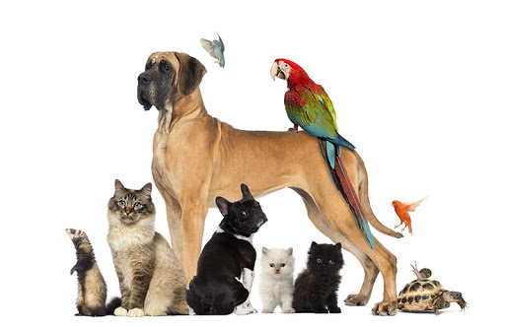
Check In
Your name?
Your pets name/s?
express a gift of your Hand/Head/Heart (1 of each 2 mins maximum)

Slide 7
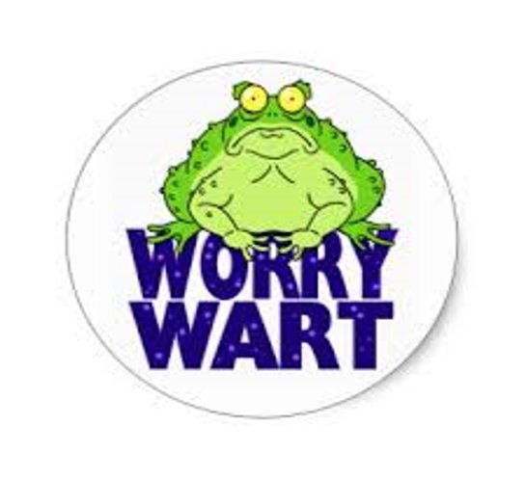
Time for your worries...

Slide 8
Act – Reflect – Learn
Act
Reflect
Learn

Slide 9
Our Purpose & Reflection Example
“Try to be the rainbow in someone’s cloud”
(Maya Angelou)

Slide 10
Your attributes (Who you are as a mentor)
Be humble
Accountable
Paying it Forward

Slide 11
Be humble - make a difference
“being humble means recognising that we are not on earth to see how important we can become, but to see how much of a difference we can make in the lives of others”
(Gordon Hinckley)
Notes:
Purpose:
Understand humility as an asset
Key points/ issues:
Humility as a core principle of peer support, everyone knows something and can contribute something, one persons experience is not worth more than another
Words you might like to use
Humility means to be free from pride and arrogance. It means
“recognising that we are not on earth to see how important we can become, but to see how much of a difference we can make in the lives of others”
Humility is the third way of being and its all about making sure that we all contribute to each other because we want to make a difference in each others life, bot because we know better and are more expert than another person.
Humility means we don’t tell each other who is right and who is wrong, we don’t judge and we don’t think we are better ..
We just have different experiences and know different things

Slide 12
Be humble – remember that:
You are no more an expert than the person next to you
The other person knows things / can do things you don’t know / can't do
What is right for you might not be right for them

Slide 13
Be accountable to build trust
Be your Word – Make your words mean something
Do what you say – Build trust in yourself and have others trust you
Hold others to their word – Build trust in each other and build a movement.
… but what if you didn’t do it – Apologise and move on!!!
Notes:
Purpose:
Everyone matters
Key points/ issues:
Because you matter what you say and do matters
Build relationships with each other that are based on trust, where what
Words you might like to use
Being accountable means saying and doing what we said we would. Doing that build trust. You and the people around you know that you said something and you will stick with it ( yes of course sometimes things get in the way and you can apologise) but basically you are the kind of person that people rely on because you said something you will do it, and you are a person who says to others, can I trust what you said, will you be your word, will you do as you said.
When we hold each other to account we build a community that trusts each other, where people can rely on each other for what we said to each other
We are a community that achieves stuff because we said
We are a community that gets stuff done because we know each other and we trust that each of us will do what they said.
We trust each other and when things go wrong we can apologise to each other and then get on with it…
Some of us believe it doesn’t matter if w do what we say because we think not so highly of ourselves and we think we don’t matter..
In the peer movement every person matters and we need to think highly of ourselves and think that each one of us can make a contribution..
And when we can hold ourselves to account then we can also hold others to account, because they matter too.

Slide 14
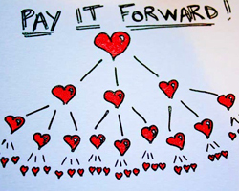
Pay it forward

Slide 15
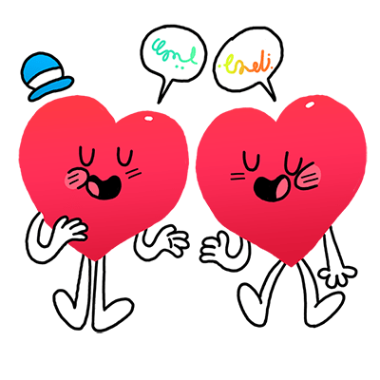
Pay it forward in community
.. and it will come back to you… !!
.. In a community it will
come around again and again and again !!
Notes:
Purpose:
Understand how pay it forward works in community
Key points/ issues:
It can be sustained if everyone contributes, nobody has to work very hard, if we all do our bit
Words you might like to use
In a community of peers Paying it forward comes back, and it come back quickly if everyone practices it
If you can offer something to one person, something will come back to you.
Its not a huge community, so if everyone pays if forward it will come back like a boomerang
One week you might mentor a person on how to fill out some Centrelink forms and how to apply for some benefits. Not much later someone from the community might share with you some tips on how to use a particular piece of equipment or how to speak up about an issue.
Paying it forward in a community is really like recycling good will and positive vibes over and over again… it keeps on going round and round…
And over time probably gets bigger, because people want to be part of it..
BUT.. It takes all of us to be generous and doing it…

Slide 16
Awareness a tricky thing Part 1

Slide 17
Awareness – a tricky thing Part 2

Slide 18
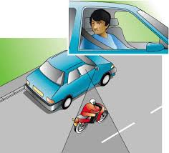
Our Blind spots (an area we are unaware of)
Yes it is ableist Language
If someone has a blind spot about something , it means they seem:
unable to understand, or
are ignorant, or
are prejudiced, or
are unaware of something.

Slide 19
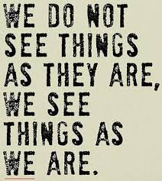
The trouble with Opinions,
we believe ours to be true and correct
Quote by Anais Nin

Slide 20
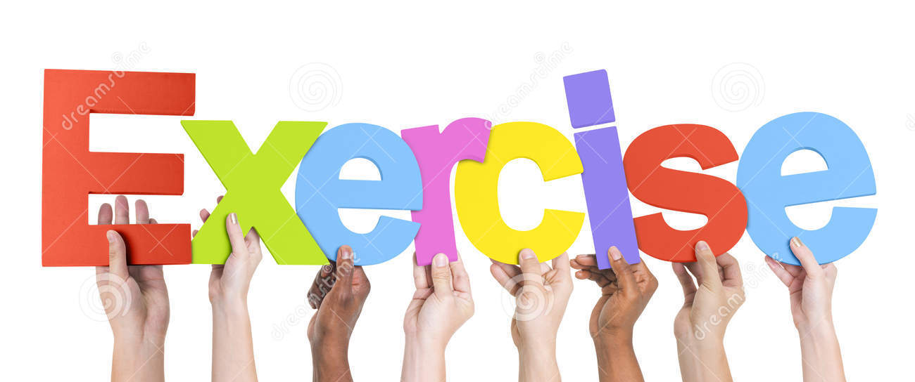
4 questions to challenge myself
How do I know that?
Who says?
Really true for never, always, in every situation..?
What does that look like if I check it out from a different point of view?

Slide 21
Meet your Learning Buddy
You will have 8 minutes in a breakout room to:
Say hello
Exchange contact details
Choose a day/time to work together before session 3
Share ONE thing you have learnt about yourself today

Slide 22
The Pitch
If you want people to choose you as a mentor, they want to know
what you got to offer,
your strengths,
your experiences,
what you know and what you can do.

Slide 23
For next session
Read the post-session slide notes
Meet up with your Learning Buddy and practice together
Work on your Pitch
Give your gifts freely
Be Accountable, pay it forward, be humble
Come back next session prepared

Slide 24
Next session
Empathy
Listening
Asking questions

Slide 25
Check out
Name a feeling/emotion/body sensation you are feeling right now

